Slide 1
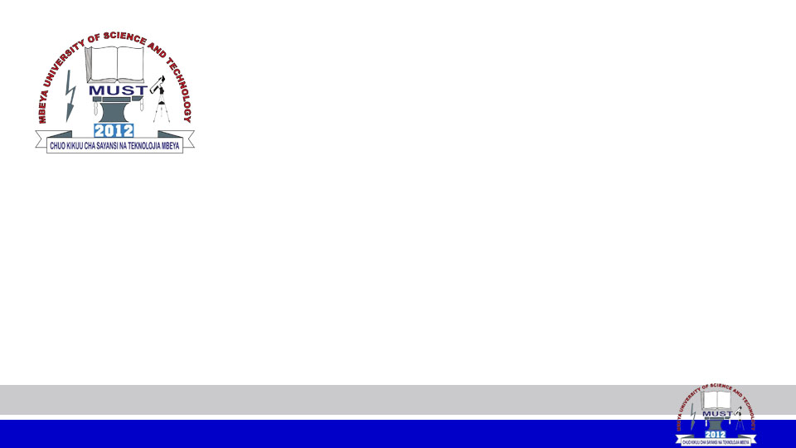
IP ADDRESSING
AND SUBNETTING
MODULE CODE: IT 6123
MODULE NAME: Network Design and Management
FACILITATOR: Pangahela, R. A
Email: pangriz@gmail.com Phone: +255 742 926 569

Slide 2
TCP/IP
TCP/IP, or Transmission Control Protocol/Internet Protocol, is a networking protocol that allows two computers to communicate over the internet.
TCP/IP was developed in the 1960s by the Department of Defense (DoD) and is based on standard protocols.

Slide 3
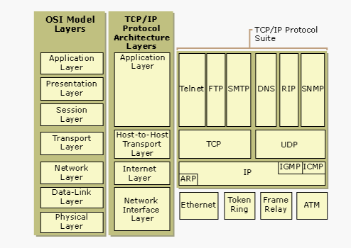
How OSI RM & TCP/IP Relate

Slide 4
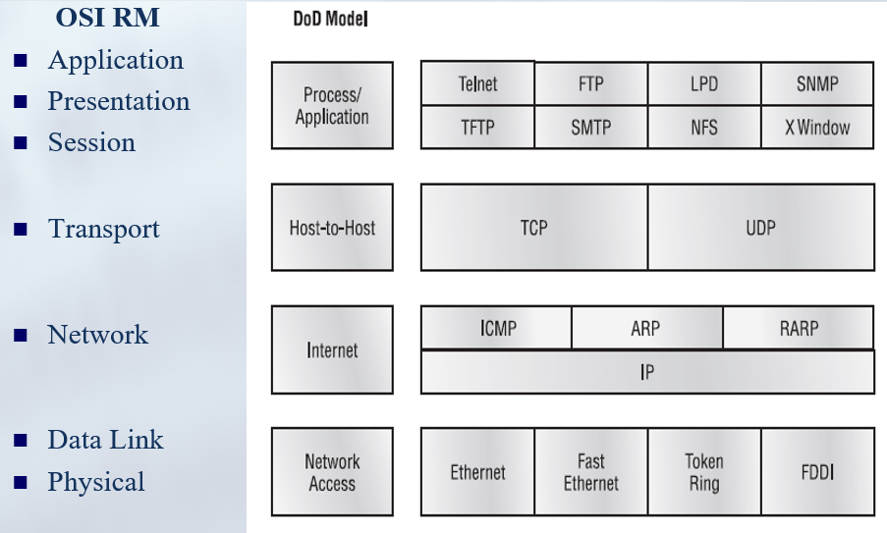
OSI RM & TCP/IP RELATION

Slide 5
IP ADDRESS FORMAT
There are two well-known IP address formats namely;
  IPv4
  IPv6.
IPv4
It is a 32-bit address format that is divided into four octets, with each octet consisting of 8 bits.

Slide 6
IPv4
The octets are separated by a dot, resulting in a format such as x.x.x.x, where x can range from 0 to 255.
  Example: 172.30.5.82
The addresses can be further divided into network and host addresses, with the network address identifying the network and the host address identifying the specific device on the network.

Slide 7

IPv4
The address is always combined with a subnet mask and typically a default gateway.
      IP: 172.30.5.82
      MASK: 255.255.255.0
      GW: 172.30.5.1
The subnet mask dictates which portions of the IP address identifies the network and host.

Slide 8
IPv4 Address types
There are three types of addresses used;
  Unicast: It is used for one-to-one communication, where a device communicates or shares data with one device only.
  Multicast: Represents a group of devices in the network. It is used for one-to-many communication, where a device communicates or shares data with multiple devices. The source address in the data packet is a unicast address, while the destination address is a multicast address. When a device receives a data packet that contains a multicast address in the destination address field, it checks whether the computer is a member of the group that the multicast address represents.

Slide 9
IPv4 Address types
Cont..;
  Broadcast: Represents all devices in the network. It is used for one-to-all communication, where a device communicates or shares data with all devices.

Slide 10
PUBLIC VS. PRIVATE ADDRESSES
Public addresses:
  Usable on the internet and internet networks
Private addresses:
  Usable only on internal networks
Three ranges of private addresses:
  Class A : 10.0.0.0 - 10.255.255.255
  Class B : 172.16.0.0 - 172.31.255.255
  Class C : 192.168.0.0 - 192.168.255.255
Loopback ranges used for testing : 127.X.X.X
Auto-configuration range : 169.254.X.X

Slide 11
Automatic Private IP address
The auto-configuration range of IP addresses used for Automatic Private IP Addressing (APIPA) is from 169.254.0.1 to 169.254.255.254.
This range provides 65,534 usable IP addresses with a subnet mask of 255.255.0.0.
APIPA is a feature in Windows OS, that allows devices to self-configure an IP address and subnet mask automatically when the DHCP server is not reachable.
This range of IP addresses is reserved for link-local addressing and is used when a device cannot obtain an IP address from a DHCP server.

Slide 12
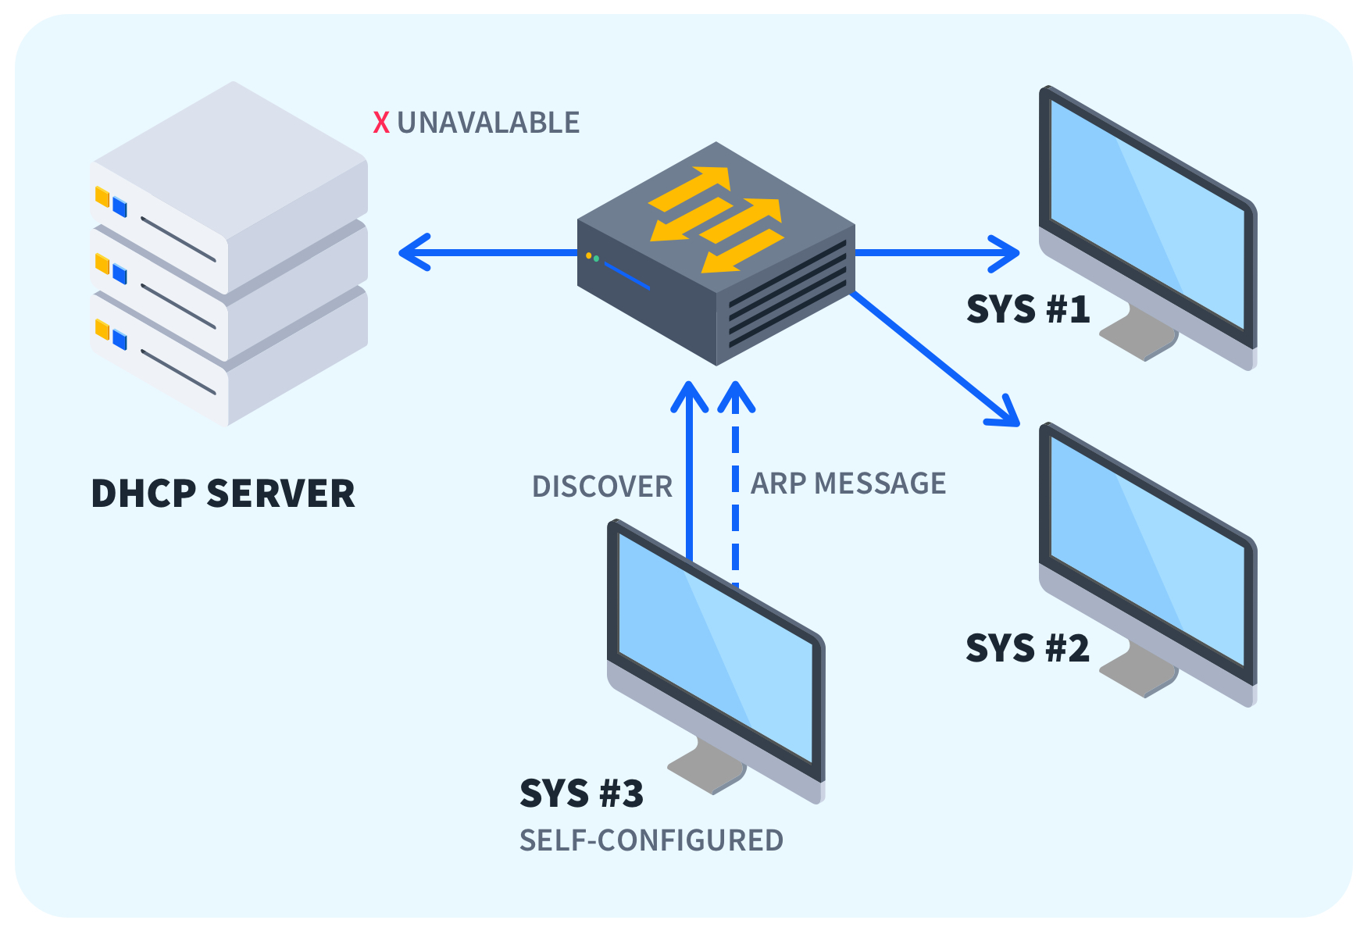
Automatic Private IP address

Slide 13
How IP addresses assigned?
At this point, you may be wondering, who assign public IP addresses and who control and supervise the whole process?
There is a global body called The Internet Assigned Numbers Authority (IANA) that is responsible for global coordination of the Internet Protocol addressing systems, as well as the Autonomous System Numbers used for routing Internet traffic.

Slide 14
How IP addresses assigned? (Cont..)
They do not directly provide IP addresses to providers and end customers though.
For every geographical region of the world, there is another regional authority that is responsible for public IP address management in the respective area.
Therefore, IANA is the authority that assigns IP addresses in large /8 blocks to the five Regional Internet Registries (RIPs).
Using these large /8 address blocks, the RIPs then provide public addresses to Service Providers, Cloud Providers, and other end customers.

Slide 15
Regional Internet Providers (RIPs)
The Regional Internet Provider for each geographical area of the world are the following;
  AFRINIC - Africa Region
  APNIC - Asia/Pacific Region
  ARIN - Canada, USA, and some Caribbean Islands
  LACNIC - Latin America and some Caribbean Islands
  RIPE NCC- Europe, the Middle East, and Central Asia

Slide 16
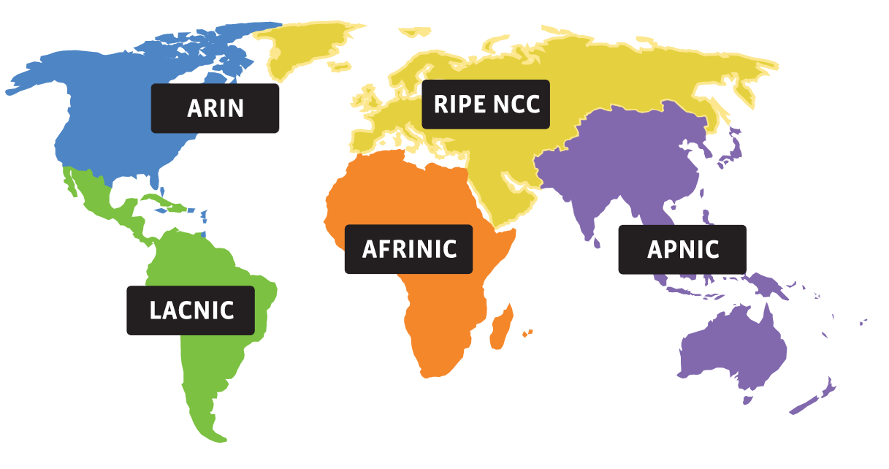
Regional Internet Providers (RIPs)

Slide 18
NETWORK LAYER
Main Functions of Network layer
  Source-to-destination delivery of a Packet
      (host to host communication)
  Possibly across multiple networks (links).
Logical addressing,
  IPv4 addressing
  The Internet addresses are 32 bits in length;
  This gives us a maximum of 2³² addresses.

Slide 19
NETWORK LAYER
IPv4 Addresses
  An IPv4 address is 32 bits long.
  It defines the connection of a device (for example, a computer or a router) to the Internet.
  Two devices on the Internet can never have the same address at the same time.
Address Space
  Total number of addresses used by the protocol.
  IPv4 uses 32-bit addresses.
  The address space is 2³² or 4,294,967,296 (more than 4 billion).

Slide 20

NETWORK LAYER
Notations
  Binary notation
    01110101 10010101 00011101 00000010
  Dotted decimal notation.
    117.149.29.2

Slide 21

NETWORK LAYER
Find the error, if any, in the following IPv4 addresses.
  111.56.045.78
  221.34.7.8.20
  75.45.301.14
  11100010.23.14.67

Slide 22
NETWORK LAYER
Classful Addressing
  The address space is divided into five classes: A, B, C, D, and E.
  We can find the class of an address when given the address in binary notation or dotted-decimal notation.

Slide 23
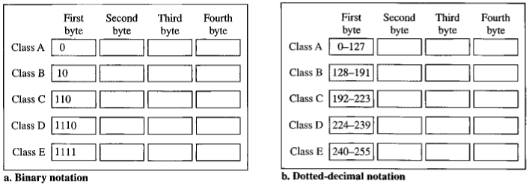

Slide 24
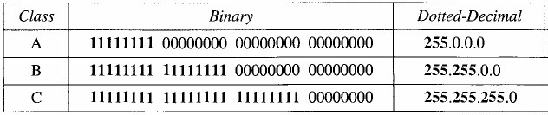
Network Layer
Netid and Hostid
  In class A, one byte defines the netid and three bytes define the hostid.
  In class B, two bytes define the netid and two bytes define the hostid.
  In class C, three bytes define the netid and one byte defines the hostid.

Slide 25
Subnetting
Subnetting divides a larger network into smaller, manageable subnetworks to improve performance and security. It uses a subnet mask (e.g, (255.255.255.0) or (/24) to split an IP address into network and host parts. Common examples include creating multiple smaller networks from single classful block (like breaking a (192.168.1.0/24) network into smaller segments). [1, 2, 3, 4]

Slide 26
Key Concepts in Subnetting
  Subnet Mask: Defines the boundary between the network part (1s) and host part (0s)
  CIDR Notation(/X): A shorthand for the subnet mask. For example, (/24) means 24 one in the mask (255.255.255.0).
  Network ID: The first address in a subnet.
  Broadcast Address: The last address, used to communicate with all hosts in the subnet.
  Usable Hosts: The range of IP addresses between the Network ID and Broadcast Address. [1, 2, 3, 4]

Slide 27
Issues in Addressing
A large corporate/campus environment
  Large number of Local Area Networks
      Some with fewer than 256 hosts
      Some with more than 256 hosts
If each physical network is assigned a network number:
Huge administrative above to manage a large number of network addresses
Routing tables in routers become extremely large (one entry for each physical network)
Insufficient number of class B prefixes to cover medium sized networks (having more than 256 hosts)

Slide 28
Subnetting
Solution: Provide the campus with a single class B network
  Give freedom to the campus network admin to allocate host numbers to hosts
  From outside, the whole campus is simply known by the class B network ID
  Inside, there may be a hierarchy that remains transparent to the outside world

Slide 29
Subnetting
Consider a class B network
  How to allocate host numbers to hosts?
  A single LAN is out of question
  If host numbers are assigned randomly, i.e., without any hierarchy, the routers inside the network will have to deal with large tables one entry per host
  Thus, a hierarchical structure is required

Slide 30
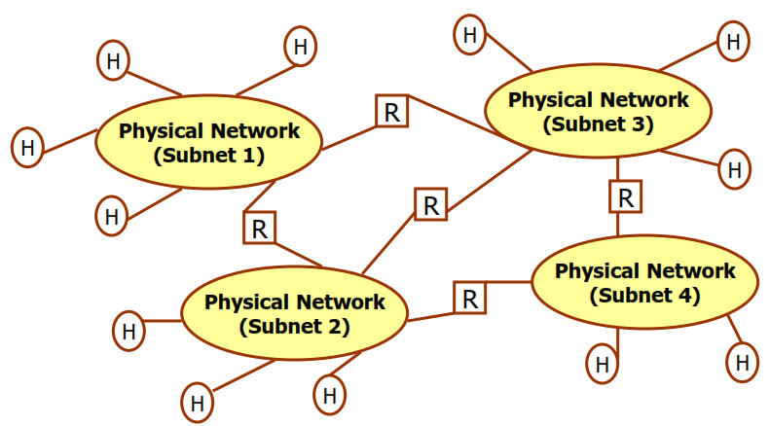
Subnetting

Slide 31
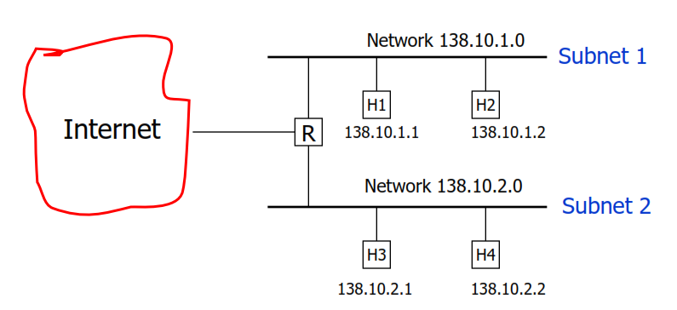
Subnetting
H1 wants to send an IP datagram to H3:
Old addressing dictates it is a “direct delivery”
With Subnetting, it may become “indirect”

Slide 32

Subnetting
We previously divided IP addresses in a network portion and a host portion
More generally, think of a 32-bit IP address as having an Internet part and a Local part
    Internet part of the IP address identifies a site (possibly with many physical networks)
    The local portion identifies a physical network and host at that site (note: physical network == extended LAN)

Slide 33
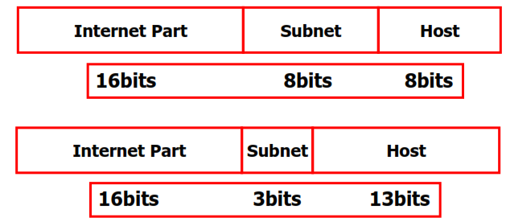
Examples: Class-B IP address

Slide 34
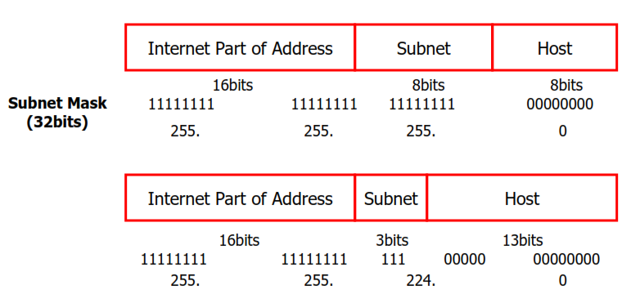
Subnet Implementation
Subnet Mask:
Specifies the bits of the IP address used to identify the subnet

Slide 35
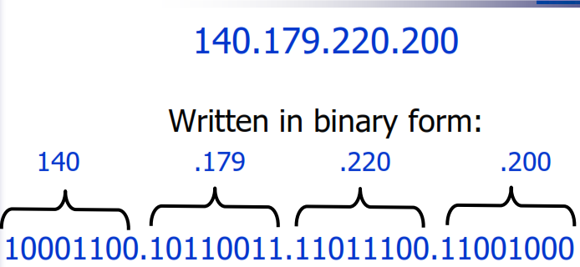
Example
We see the address in the decimal form
Your computer sees it in the binary form

Slide 36
Binary Octet:
An octet is made up of eight “1”s and/or “0”s, representing the following values:
128 64 32 16 8 4 2 1
So the value of 140 (the first octet of our example) looks like this:
1 0 0 0 1 1 0 0

Slide 37
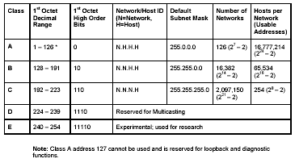
Network Layer

Slide 38
Network vs. Host
Every IP address has 2 parts:
  1 identifying the network it resides on
  1 identifying the host address on the network
The class of the address and the subnet mask determine which part belongs to the network address and which part belongs to the host address

Slide 39
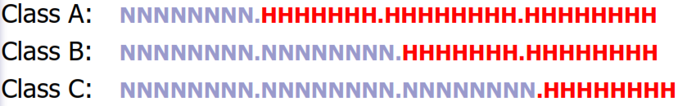
IP Address Breakdowns:
The class of the address determines, by default, which part is for the network (N) and which part belongs to the host (H)

Slide 40
140.179.220.200
Our example is a Class B address
By default, the Network part of the address is defined by the first 2 octets: 140.179.x.x
By default, the Host part of the address is defined by the last 2 octets: x.x.220.200
*Note:
The network part of the address is also known as the Network Address

Slide 41
Two Reserved Addresses on a Subnet:
In order to specify the Network Address of a given IP address, the Host portion is set to all “0”s:
    140.179.0.0
If all the bits in the Host portion are set to “1”s, then this specifies the broadcast address that is sent to all hosts on the network:
    140.179.255.255

Slide 42

SUBNETTING

Slide 43
Subnetting
Subnetting an IP network can be done for various reasons including:
     Preservation of address space
     Security
     Control network traffic

Slide 44
Example Class A
Millions of Addresses Available
  Over 16,000,000
Efficiency
  Non-subnetted networks are wasteful
  Division of networks not optimal
Smaller Network
  Easier to manage
  Smaller broadcast domains

Slide 45
Subnet Mask
Subnet masks are applied to an IP address to identify the Network portion and the Host portion of the address.
Your computer performs a bitwise logical AND operation between the address and the subnet mask in order to find the Network Address or number.

Slide 46
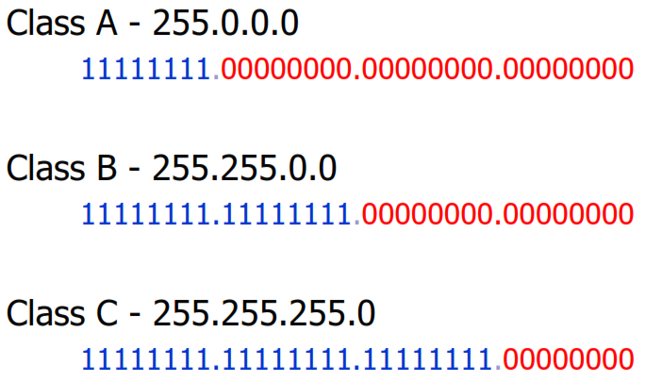
Default Subnet Masks

Slide 47
Logical Bitwise AND Operation
Remember our example?
  140.179.240.200
It’s a Class B, so the subnet mask is:
  255.255.0.0
We need to look at this as our computer does so
we can perform the bitwise AND...

Slide 48
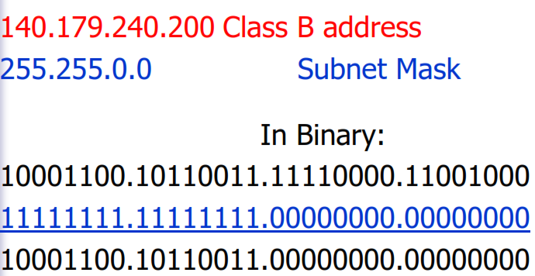
Logical Bitwise AND Operation
By doing this, the computer has found that our
Network Address is 140.179.0.0

Slide 49
Another Example:
Suppose we have the address of: 206.15.143.89?
What class is it? Class C
What is the subnet mask? 255.255.255.0
What is the Network Address? 206.15.143.0
What is the host portion of the address? 0.0.0.89

Slide 50
Why Do We Care!?
You can manipulate your subnet mask in order to create more network addresses. Why?
If you have a Class C network, how many individual host addresses can you have?
  1 to 254
  Remember, you can’t have all “0”s and all “1”s in the host portion of the address.
  So we cannot use 206.25.143.0 (all “0”s) or 206.25.143.255 (all “1”s) as a host address.

Slide 51
Why Do We Care!?
  So we have 1 Class C Network (206.15.143.0)
  And we have 254 host address (1 to 254)
  But what if our LAN has 5 networks in it and each network has no more than 30 hosts on it?
  Do we apply for 4 more Class C licenses, so we have one for each network?
  We would be wasting 224 addresses on each network, a total of 1120 addresses!

Slide 52
Subnetting
Subnetting is a way of taking an existing class license and breaking it down to create more Network Addresses.
This will always reduce the number of host addresses for a given network.
Subnetting makes more efficient use of the address or addresses assigned to you.

Slide 53
How Does Subnetting Work?
Additional bits can be added (changed from 0 to 1) to the subnet mask to further subnet, or breakdown, a network.
When the logical AND is done by the computer, the result will give it a new Network (or Subnet) Address.
Remember, an address of all “0”s or all “1”s cannot be used in the last octet (or host portion). All “0”s signify the Network Address and all “1”s signify the broadcast address

Slide 54
So How Does This Work?
We ask our ISP for a Class C license.
They give us the Class C bank of 206.15.143.0
This gives us 1 Network (206.15.143.0) with the potential for 254 host addresses (206.15.143.1 to 206.15.143.254).
But we have a LAN made up of 5 Networks with the largest one serving 25 hosts.
So we need to Subnet our 1 IP address...

Slide 55
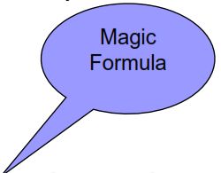
  So How Does This Work?
To calculate the number of subnets (networks) and/or hosts, we need to do some math:
Use the formula 2^{n}-2 where the n can represent either how many subnets (networks) needed OR how many hosts per subnet needed.

Slide 56
So How Does This Work?
We know we need at least 5 subnets. So 2³-2 will give us 6 subnet addresses (Network Addresses).
We know we need at least 25 hosts per network. 2⁵-2 will give us 30 hosts per subnet (network).
This will work, because we can steal the first 3 bits from the host’s portion of the address to give to the network portion and still have 5 (8-3) left for the host portion:

Slide 57
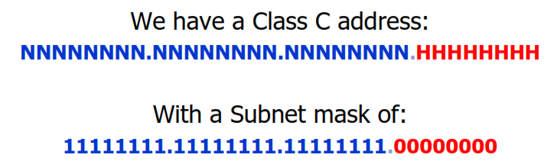
Break it down:
Let’s go back to what portion is what:
We need to steal 3 bits from the host portion to give it to the Network portion:
NNNNNNNN.NNNNNNNN.NNNNNNNN.NNNHHHHH

Slide 58
Break it down:
NNNNNNNN.NNNNNNNN.NNNNNNNN.NNNHHHHH
This will change our subnet mask to the following:
11111111.11111111.11111111.11100000
Above is how the computer will see our new subnet mask, but we need to express it in decimal form as well:
255.255.255.224 128+64+32=224

Slide 59
What address is what?
Which of our 254 addresses will be a Subnet (or Network) address and which will be our host addresses?
Because we are using the first 3 bits for our subnet mask, we can configure them into eight different ways (binary form):
000 001
010 011
100 101
110 111

Slide 60
What address is what?
We cannot use all “0”s or all “1”s
000 001
010 011
100 101
110 111
We are left with 6 useable network numbers.

Slide 61
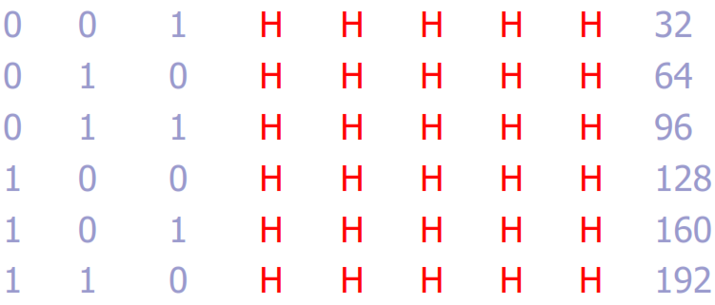
Network (Subnet) Addresses
Remember our values:
128 64 32 16 8 4 2 1 Equals
Now our 3 bit configurations:

Slide 62
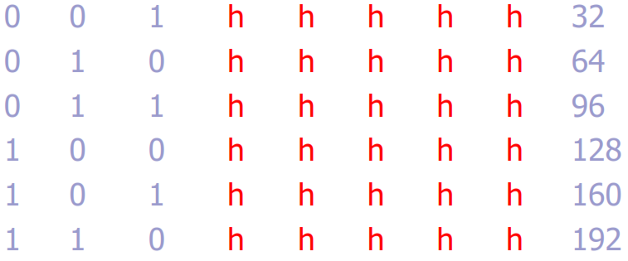
Network (Subnet) Addresses
Each of these numbers becomes the Network Address of their subnet...

Slide 63
Network (Subnet) Addresses
206.15.143.32
206.15.143.64
206.15.143.96
206.15.143.128
206.15.143.160
206.15.143.192

Slide 64
host Addresses
The device assigned the first address will receive the first number AFTER the network address shown before.
206.15.143.33 or 32+1
0 0 1 0 0 0 0 1
And the last address in the Network will look like this:
206.15.143.62
0 0 1 1 1 1 1 0
Remember, we cannot use all “1”s, that is the broadcast address (206.15.143.63)

Slide 65
Host Addresses
The next network will start at 206.15.143.64
The first IP address on this subnet network will receive:
206.15.143.65
0 1 0 0 0 0 0 1
And the last address in the Network will receive:
206.15.143.94
0 1 0 1 1 1 1 0
*Remember, the broadcast address (206.15.143.95)

Slide 66
Can you figure out the rest?
Network: Host Range
206.15.143.32 206.15.143.33 to 206.15.143.62
206.15.143.64 206.15.143.65 to 206.15.143.94
206.15.143.96 206.15.143.97 to 206.15.143.126
206.15.143.128 206.15.143.129 to 206.15.143.158
206.15.143.160 206.15.143.161 to 206.15.143.190
206.15.143.192 206.15.143.193 to 206.15.143.222

Slide 67
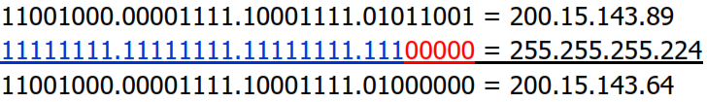
How the computer finds the Network Address:
        200.15.143.89 An address on the subnet
        225.225.225.224 The new subnet mask
When the computer does the Logical Bitwise AND Operation it will come up with the following Network Address (or Subnet Address):
This address falls on our 2nd Subnet (Network)

Slide 69
Review
We have one class C license.
We need to subnet that into 12 possible networks.
Each network needs a maximum of 10 hosts.
How many bits do we need to take?
2⁴-2=14
4 bits need to be taken from the host portion and given to the network portion.

Slide 70
Review
Will that leave enough bits for the host portion? We need a maximum of 10 on each network…
2⁴-2=14
If we take 4 away, that leaves us with 4. That is enough for our individual networks of 10 hosts each.

Slide 71
Review
Our new subnet mask will look like this:
11111111.11111111.11111111.11110000
255.255.255.240 128+64+32+16= 240
Our subnet, or network addresses will be:
  206.15.143.16 206.15.143.32 206.15.143.48
  206.15.143.64 206.15.143.80 206.15.143.96
  206.15.143.112 206.15.143.128 206.15.143.144
  206.15.143.160 206.15.143.176 206.15.143.192
  206.15.143.208 206.15.143.224

Slide 72
Subnetting
It is recommended that sites use contiguous subnet masks
  Avoid masks such as
11111111 11111111 11000010 11000000
  When choosing a subnet mask, balance:
    Size of networks
    Number of networks
    Expected growth
    Ease of maintenance
  It is possible to use different masks in different parts of the network

Slide 73
Review
Let's say that you need to subnet the network address 199.42.78.0 using the subnet mask 255.255.255.224.
  What are the valid subnets that you can obtain from the given subnet mask?
  What is the broadcast address of each subnet?
  What are the valid hosts in each of the subnets?
  What subnet mask should you use if you need x subnets and y hosts?

Slide 74
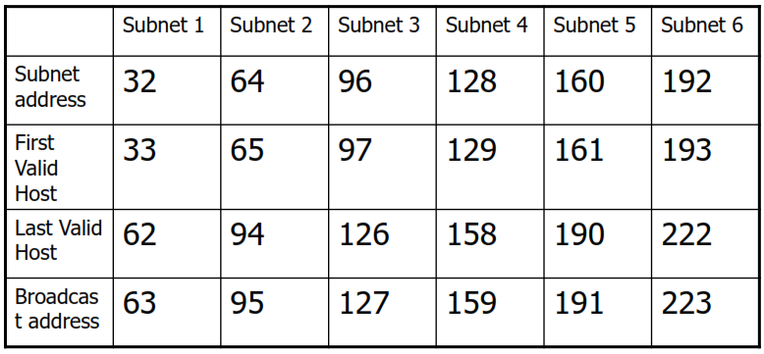
Solution

Slide 75
Review
Using the subnet mask 255.255.255.224, what is the subnet that the host 199.42.78.133 belongs to and the broadcast for this address?
Solution:
  Formula 256 – subnet mask = base number.
  256-224=32, which is your first subnet.
  Add the 32 to itself until you reach the subnet that contains the host 133.
    32+32=64, 64+32=96, 96+32=128, 128+32=160.
    Stop here because 133 is between 128 and 160.
    Address 199.42.78.133 belongs within the 199.42.78.128.
    The broadcast address is 199.42.78.159

Slide 76
Home Assignment
Given the network address 172.16.68.17 and the subnet mask 255.255.192.0, find the subnet it belongs to and its broadcast?

Slide 77
CLASS QUIZ

Slide 78
An IP network address has been subnetted so that every subnetwork has 30 usable host IP addresses. What is the appropriate subnet mask for the newly created subnetwork?
  255.255.255.252
  255.255.255.248
  255.255.255.240
  255.255.255.224
  255.255.255.128

Slide 79
IPv6

Slide 80
END
THANK YOU

